Slide 1
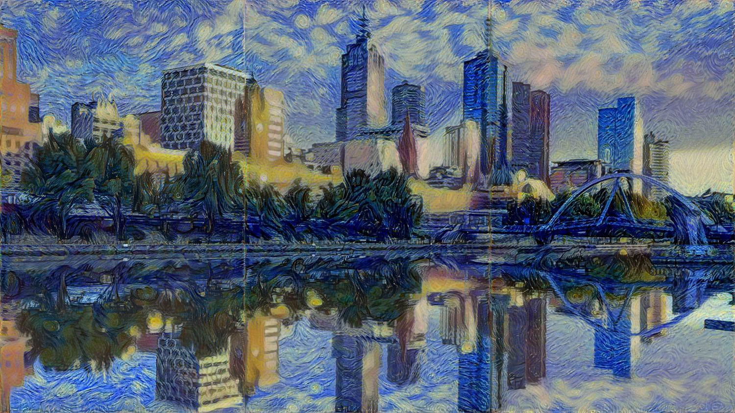
PAINTING LIKE VAN GOGH WITH CNNS - A CASE STUDY ON ARTISTIC STYLE TRANSFER USING CNNS
HENA LEE
DESEN LIU
MADHAVI POLISETTI
ELYSE ZHANG
DEC 4TH 2018
Notes:
Hena, Desen, Elyse and I worked on this case of Artistic Style Transfer using CNNs.

Slide 2
AGENDA
Introduction
How does it work
Re-cap of CNNs
An example of deep CNNs - VGG19 architecture
Algorithm Walkthrough
Putting it together - Painting Style and Content
Final notes: Future work/ Enhancements
Notes:
Here is our agenda for the presentation. I will cover the introduction. Hena and Desen will present different pieces of our algorithm. Elyse will explain our implementation results. I will conclude with final notes.

Slide 3
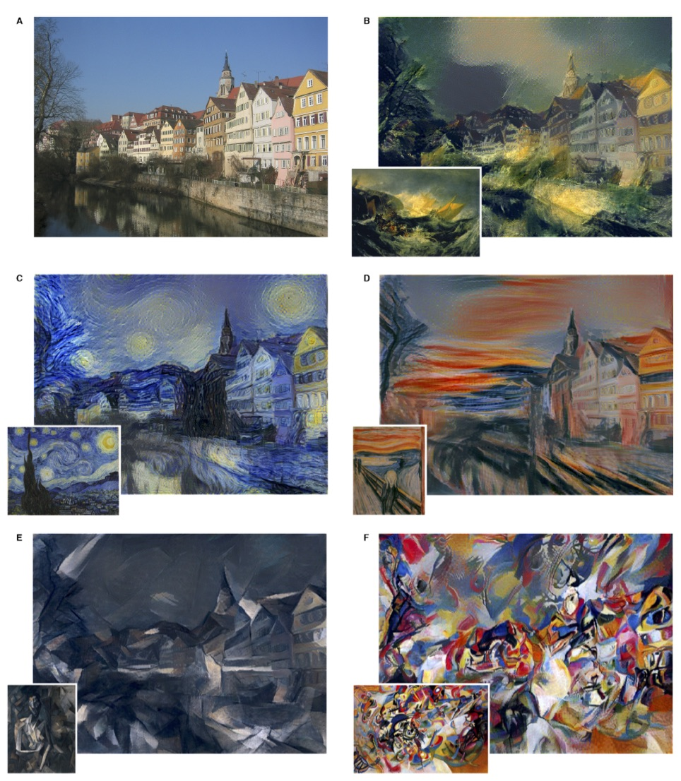
INTRODUCTION
A paper named Neural Algorithm of Artistic Style first published in August 2015.
Style transfer is the process of re-imagining one image in the style of another.
Style transfer -- not the same as Instagram filters.
For this, Output from convolutional layers in a CNN model are deconstructed such that content and style can be separated.
B The Shipwreck of the Minotaur by J.M.W. Turner, 1805. C The Starry Night by Vincent van Gogh, 1889. D Der Schrei by Edvard Munch, 1893. E Femme nue assise by Pablo Picasso, 1910. F Composition VII by Wassily Kandinsky, 1913.
Notes:
1. First paper on the topic was published in August 2015.
2. Image on the right illustrates the technique discussed in the paper. The authors modified the image of Thurbingen(Thuubigen), Germany using their algorithm and applied 5 artistic styles such as Munch, Picasso and VanGogh.
3. Read Bullet 2
3. Instagram filters: Image filters add or remove features from an image. For e.g: smoothing edges, sharpening edges.
4. However, Style transfer is like painting a blank grey canvas using two different brushes: one for content and other for style.
5. To do so, Output from different CNN layers are used to separate style from content.

Slide 4

HOW DOES THIS MODEL PAINT LIKE AN ARTIST?
Re-cap of CNNs
Detect different features within an image and use these to identify objects
Notes:
https://medium.com/data-science-group-iitr/artistic-style-transfer-with-convolutional-neural-network-7ce2476039fd
https://medium.com/@shivamgoel1791/everything-you-need-to-know-about-neural-style-transfer-994530cc9a6e
https://medium.freecodecamp.org/an-intuitive-guide-to-convolutional-neural-networks-260c2de0a050

Slide 5
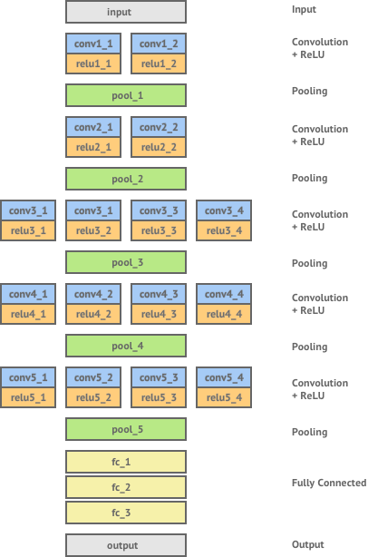
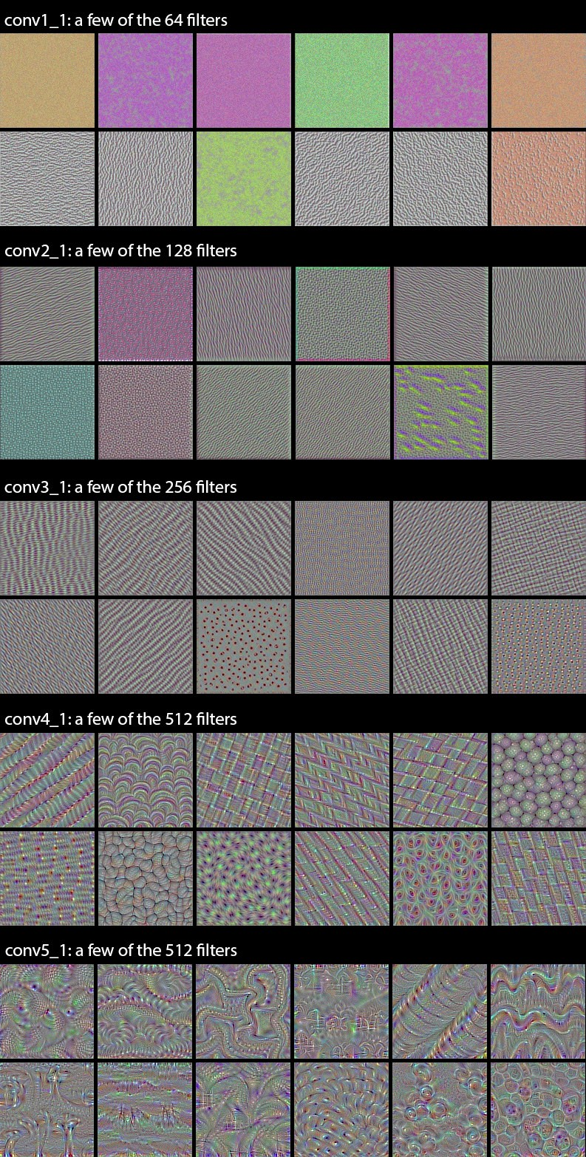
HOW DOES THIS MODEL PAINT LIKE AN ARTIST?
Deep CNNs – VGG (Visual Geometry Group) 19 model architecture
To investigate how depth affects the accuracy in large-scale image
Use 3x3 filters in all convolutional layers
Notes:
https://shafeentejani.github.io/2016-12-27/style-transfer/
http://www.subsubroutine.com/sub-subroutine/2016/11/12/painting-like-van-gogh-with-convolutional-neural-networks
https://medium.com/@shivamgoel1791/everything-you-need-to-know-about-neural-style-transfer-994530cc9a6e

Slide 6
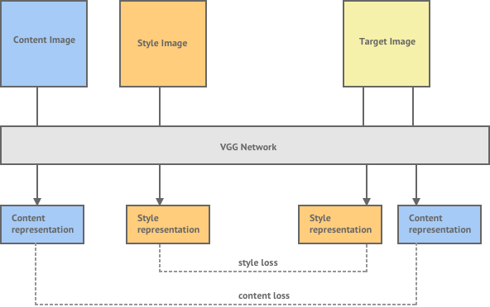
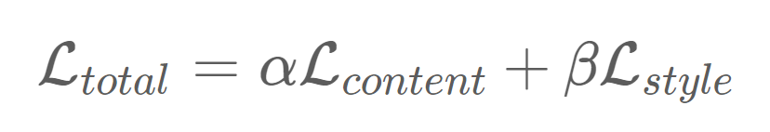
HOW DOES THIS MODEL PAINT LIKE AN ARTIST?
Notes:
L-BFGS optimisation algorithm below
http://www.subsubroutine.com/sub-subroutine/2016/11/12/painting-like-van-gogh-with-convolutional-neural-networks
Optimization Method in article below
https://medium.com/artists-and-machine-intelligence/neural-artistic-style-transfer-a-comprehensive-look-f54d8649c199

Slide 7
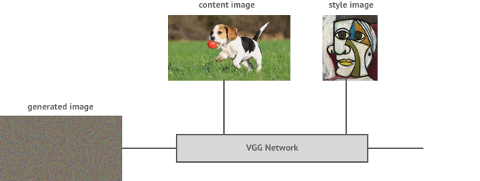
HOW DOES THIS MODEL PAINT LIKE AN ARTIST?
Process Map
Notes:
https://shafeentejani.github.io/assets/images/style_transfer/image_generation_gif/image_generation.gif
http://www.subsubroutine.com/sub-subroutine/2016/11/12/painting-like-van-gogh-with-convolutional-neural-networks
Optimization Method in article below
https://medium.com/artists-and-machine-intelligence/neural-artistic-style-transfer-a-comprehensive-look-f54d8649c199

Slide 8
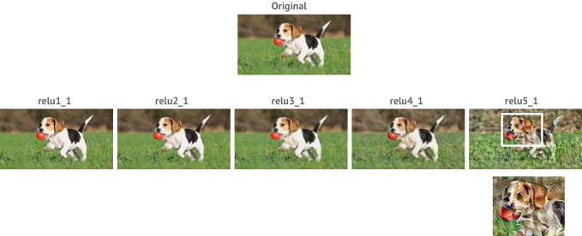
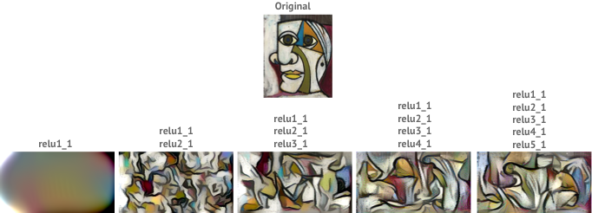
- Content image representation - feature map
HOW DOES THIS MODEL PAINT LIKE AN ARTIST?
- Style image representation - spatial correlation (gram matrix of a feature map)
Notes:
L-BFGS optimisation algorithm below
http://www.subsubroutine.com/sub-subroutine/2016/11/12/painting-like-van-gogh-with-convolutional-neural-networks
Optimization Method in article below
https://medium.com/artists-and-machine-intelligence/neural-artistic-style-transfer-a-comprehensive-look-f54d8649c199

Slide 9
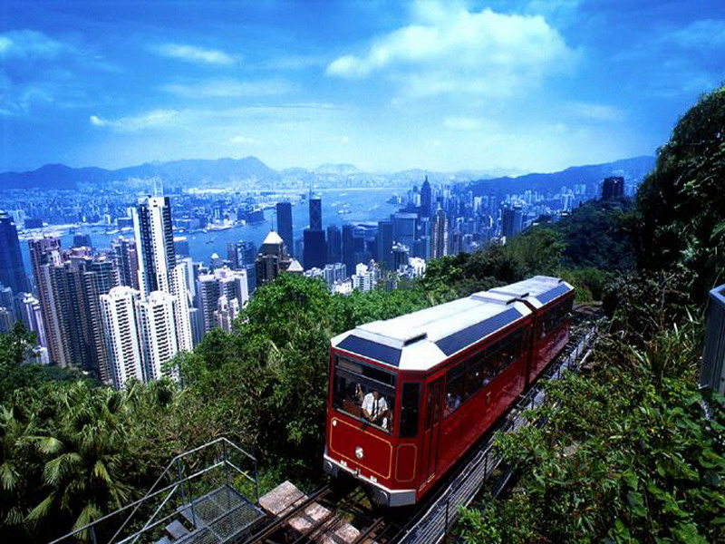
Implementing “artistic style transfer = content + style”
IMPLEMENTATION EXAMPLES
Notes:
As Desen mentioned, the algorithm was to be fed content and style. We used the content of “Hongkong Peak Tram” image and applied style of 3 different artist’s images.

Slide 10
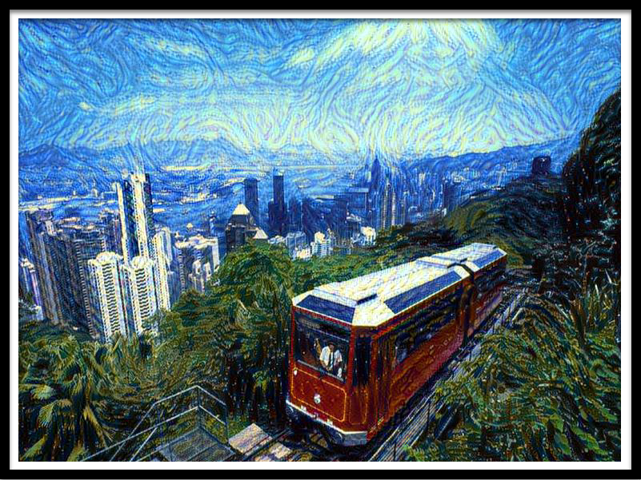
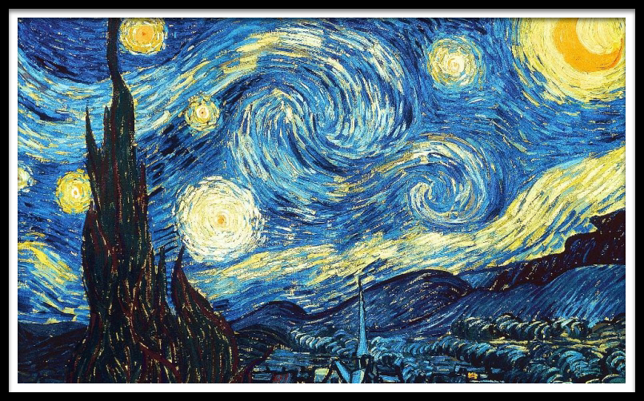
IMPLEMENTATION EXAMPLES – VAN GOGH

Slide 11
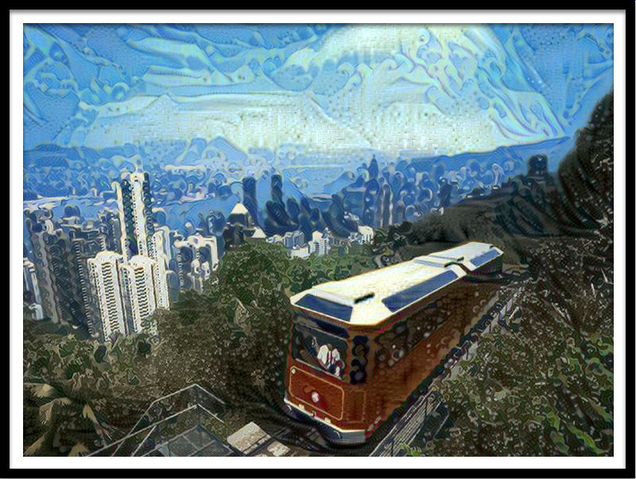
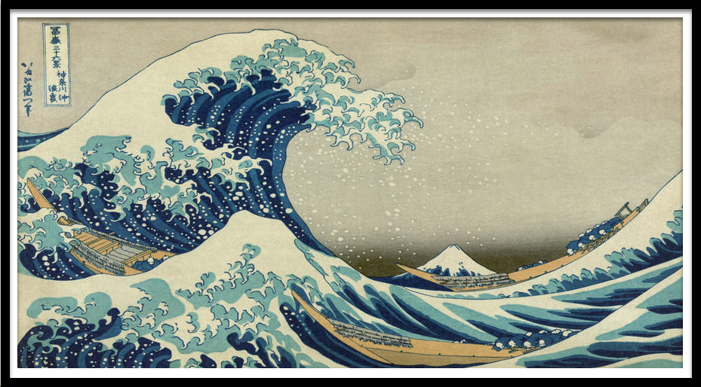
IMPLEMENTATION EXAMPLES – HOKUSAI

Slide 12
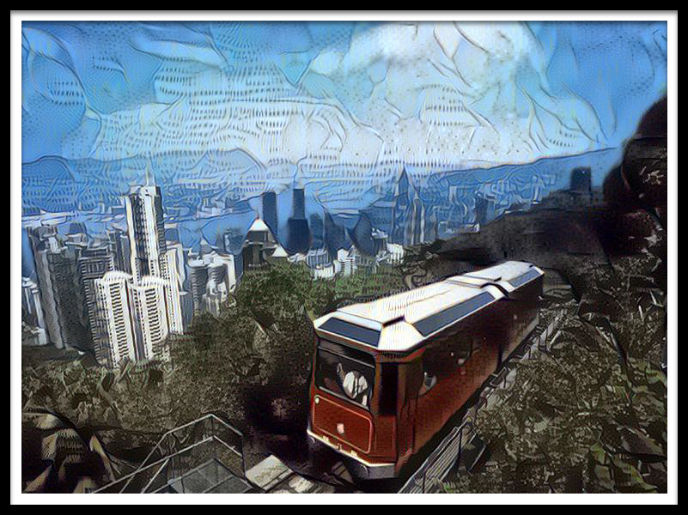
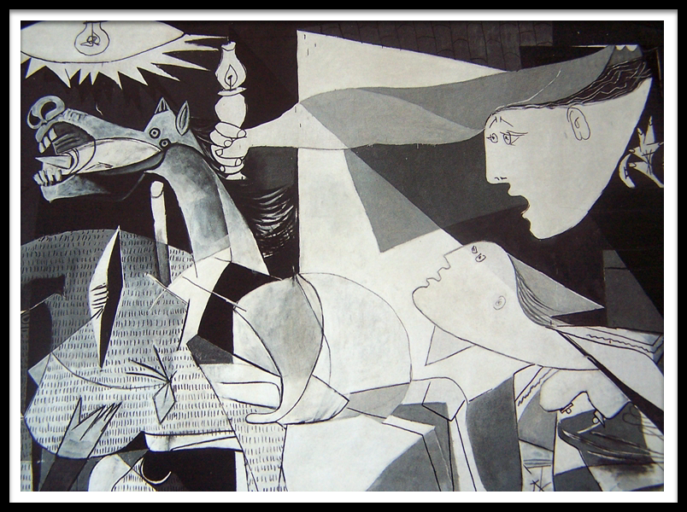
IMPLEMENTATION EXAMPLES – PICASSO
Notes:
Picasso style had cut outs in the desired shape .

Slide 13
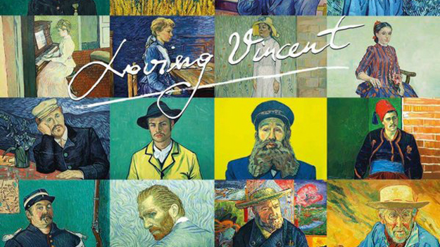

Slide 14
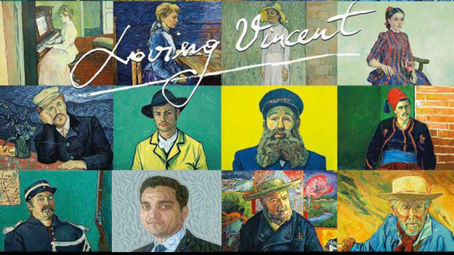
Notes:
This is a collage Van Gogh style imitations. But there is an image of someone in this classroom that we modified with the algorithm. Can you spot it?

Slide 15
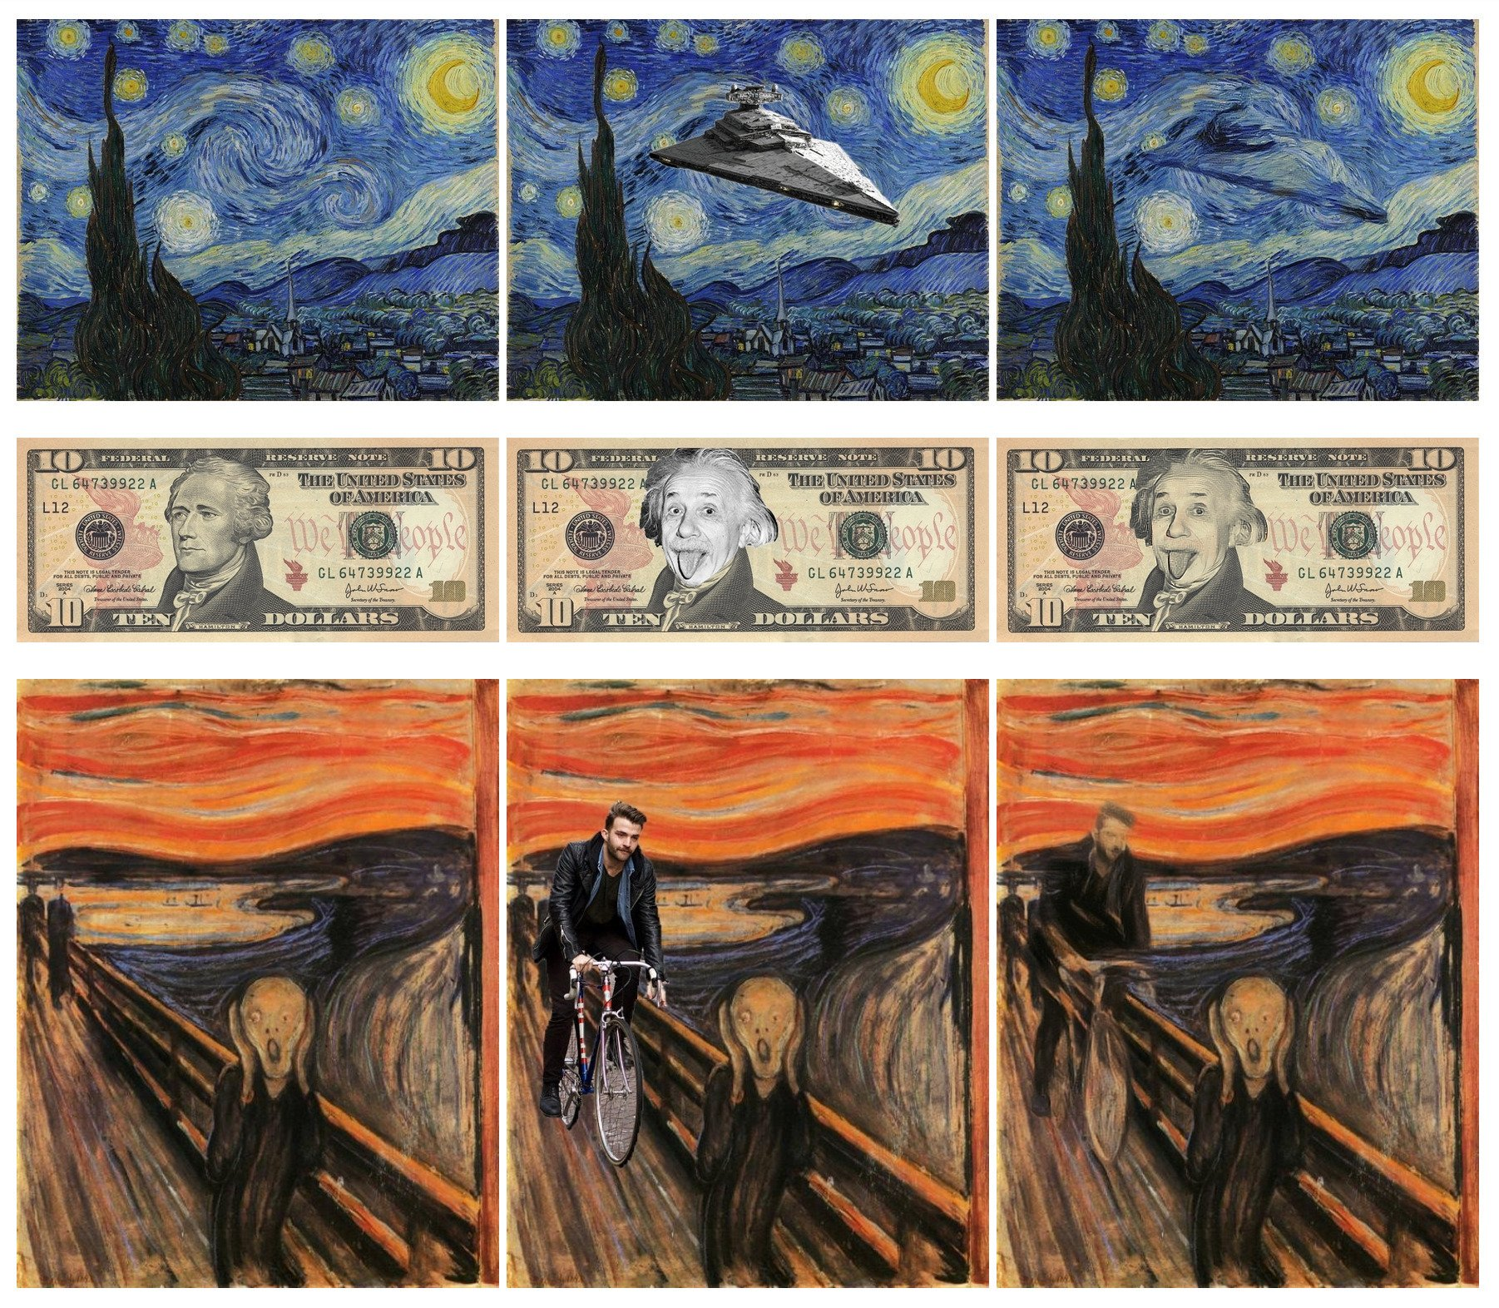
FINAL NOTES: ENHANCING THE ALGORITHM
Current Algorithm with:
Optimization algorithms
Different feature maps from the layers
Other network architectures
Vary lambda (weight of content image relative to style image), etc.
Add-ons:
Implementing “Deep Painterly Harmonization”
Notes:
“Deep Painterly Harmonization” is copying an element from a photo into a painting and making the element part of painting. This algorithm builds on the Artistic Style transfer. This is illustrated in the image on the right.

Slide 16
THANK YOU

